Slide 1
How to Get Published in Science and Other High-Impact Journals
A Guide to scientific writing
Nancy r. gough, Editor of Science Signaling

Slide 2
AAAS: Journal publisher and so much more
Mission: Advance science for the benefit of all people
Visit www.aaas.org for details
ENHANCING GLOBAL POLICY & PUBLIC SUPPORTING
EDUCATION OUTREACH ADVOCACY ENGAGEMENT CAREERS
Notes:
AAAS was founded in 1848 with the stated goals of promoting cooperation among scientists, defending scientific freedom, encouraging scientific responsibility, and supporting scientific education and outreach for the betterment of all humanity. It is the world's largest and most prestigious general scientific society, with 126,995 individual and institutional members at the end of 2008,^{[1]} and is the publisher of the well-known scientific journal Science, which has a weekly circulation of 138,549

Slide 3
The Science Family of Journals
First issues in1880
Weekly in print and online
Interdisciplinary scientific journal
Subscription

Slide 4
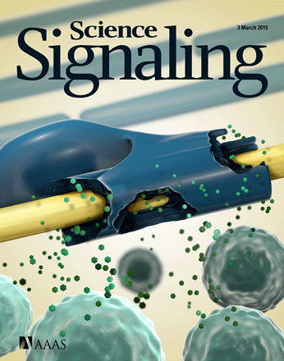
The Science Family of Journals
First issues in1999 (Science’s STKE)
Relaunch with new title 2008
Weekly online
Specialty journal: cellular and organismal signaling in physiology and disease
Subscription

Slide 5
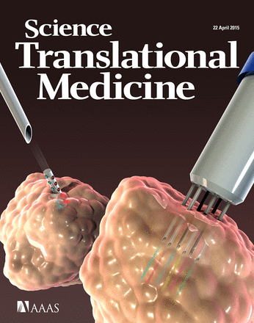
The Science Family of Journals
First issues in 2009
Weekly online
Specialty journal: biomedical research from basic, translational, and clinical researchers
Subscription

Slide 6
The Science Family of Journals
First articles in 2015
Continuous online publication
Interdisciplinary scientific journal
Open access (author pays)

Slide 7
Where to submit?
Journal scope and audience
Review process and criteria
Impact factor
Article types and format
Editorial board
Sister journals
Access

Slide 8
Submissions and Acceptance Rate
2014
Submissions >11500 >700 >2600 n.d.
Acceptance 6% 19% 7% n.d.

Slide 9
Review process
Professional editors
Staff editors & Board of Reviewing Editors- review or reject?
External in-depth review
Reject, revise, accept
Assist authors communicate research
Academic editors
Review or reject?
Can serve as reviewers or send for external in-depth review
Reject, revise, accept

Slide 10
Value of professional editors
Have the power to overrule reviewers (and Board members)
Highly skilled in finding appropriate reviewers
Broad knowledge of the field and literature
Not distracted by their “real” job
Enhance accessibility of papers
Invite commentary featuring research
Help authors communicate scientific findings effectively

Slide 11
Gold versus Green Open Access
Gold Open Access
Authors pay full publication costs*
Articles are available immediately upon publication without fee to the reader
*generally not feasible for journals with professional editors, reviews and commentary, or news
Science Advances
Green Open Access
Authors pay only a small part of the publication costs
Subscribers (institutional or individual) pay for immediate access
Nonsubscribers can pay to access individual articles
Science
Science Signaling
Science Translational Medicine
Notes:
Article processing charges for Science Advances are 3,000 or 4,000 depending on which license. Discounts are available for AAAS members, scientists at subscribing institutions (??)

Slide 12
Access to Science, Science Signaling, and Science Translational Medicine
Immediate access: Research authors receive a toll-free link to their article immediately after publication.
6 months after publication: Accepted version of peer-reviewed content can be posted in authorized public repositories (PMC).
12 months after publication: Research content is freely available at the journal’s website.

Slide 13
Submit to Science?
Is your finding a big step forward with broad implications?
Is your paper cross disciplinary?
Did you apply a new technique to investigate difficult scientific questions?
Is your research in the biological, physical, or social sciences?
Is your study self-contained and suitable for the Science format?

Slide 14
Submit to Science Signaling?
Do you study cellular or organismal regulation:
with implications for understanding physiology and pathophysiology?
with implications for understanding or treating disease?
with mechanistic insight?
with computational or modeling analysis leading to tested prediction?
Was your paper recommended from Science or Science Translational Medicine?

Slide 15
Research Article or Research Resource?
Is the study hypothesis-driven and are the hypotheses tested?
Does the study provide a significant advance in understanding biological regulation?
Research Article

Slide 16
Research Article or Research Resource?
Is the study not testing a specific hypothesis?
Does the study present a novel technique or tool with validation, without investigating a biological question?
Does the study provide a validated data set or describe applications of a validated database?
Research Resource

Slide 17
Submit to Science Translational Medicine?
Does your research advance preclinical biomedical discoveries toward improved patient care?
Does your research advance engineering discoveries toward improved patient care?
Does your research take clinical observations back to the lab for mechanistic studies?
Does your research inform health policy?
Was your paper recommended by Science or Science Signaling?

Slide 18
Submit to Science Advances?
Is your finding a step forward with a broad implication?
Is your paper cross disciplinary?
Is your research in the biological, physical, or social sciences?
Does your funding agency require publication in an open access journal?
Was your paper recommended from a Science journal?

Slide 19
Practical tips to getting published
A guide to scientific writing

Slide 20
5 Golden Rules
Know your audience
Write clearly
Write concisely
Write accurately
Follow instructions

Slide 21
When writing, think like…
Your family
They’re intelligent.
The funder
She gets lots of requests for money.
The editor
She has 20-30 active manuscripts.
She is not an expert in your field.
She handles multiple presubmission inquiries a day.
They don’t know your experiments.
They want to understand.
She has 5 minutes before the next meeting.
She wants to support research.
She fields multiple inquiries from authors a day.
She wants to find the best papers.

Slide 22
Audience
Scientists in your field
Scientists outside of your field
Reviewers
Editors
Press and general public
These people are drowning in information
and very busy!

Slide 23
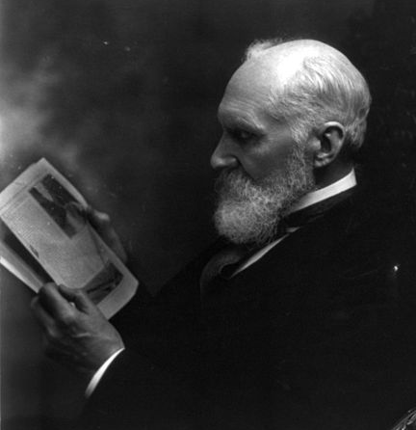
Think like a reviewer
Run your own review process
A scientist in your own specialty
A scientist in an unrelated specialty
A good editor for the English language

Slide 24
Reviewing the manuscript
The research
Is the result important?
Do the conclusions advance new concepts?
Is the approach original?
Are the data reliable and reproducible (how many n)?
Are the data properly quantified and statistically evaluated?
Are experiments properly controlled?
The presentation
Are errors and typos eliminated?
Does the text read smoothly?
Are needlessly convoluted sentences avoided?
Are the results described and not just a written statement of the data?
Are the figures clear, well labeled, and selected to show the most critical information?
Does the discussion appropriately account for other research?

Slide 25
Think like a reviewer for a Science journal
If correct, would this paper be interesting enough for a Science journal?
If you saw this paper in Science, Science Signaling, Science Translational Medicine, or Science Advances would you say
“Cool!”
“This changes my entire way of thinking!”
“I can’t wait to share this with my lab!”
“What were those idiot editors thinking?”

Slide 26
The cover letter
This is your chance to speak directly to the editor.
Explain the overall context of your results. What problem do they solve?
Explain why you are excited about your work. (Don’t forget to do these in the paper, also!)
Keep it short, preferably 1 page.
Have someone else proofread and edit it, especially if English is not your first language.
If you are re-using your cover letter from submission of the paper to another journal, don’t forget to change the name of the journal!!!

Slide 27
Think like an editor
Are there good reasons to reject this paper?
Are there good reasons to proceed with this paper?
Is the paper within the journal’s scope?
Is the paper competitive?
Can I convince my fellow editors of the value of this paper?
Notes:
Files tack image credit: By Niklas Bildhauer (who also is User gerolsteiner91. (originally posted to Flickr as folder)
[CC BY-SA 2.0 (http://creativecommons.org/licenses/by-sa/2.0)], via Wikimedia Commons

Slide 28
Think like an editor
Can I grasp the main finding and importance from the abstract and cover letter?
Is the title reflective of the main findings of the study?
If I am having trouble grasping the message because of awkward writing or poorly presented figures, how will reviewers react?
Notes:
Files tack image credit: By Niklas Bildhauer (who also is User gerolsteiner91. (originally posted to Flickr as folder)
[CC BY-SA 2.0 (http://creativecommons.org/licenses/by-sa/2.0)], via Wikimedia Commons

Slide 29
Rewrite and edit for clarity
Make sure that every word in every sentence says what you really mean!
Notes:
Files tack image credit: By Niklas Bildhauer (who also is User gerolsteiner91. (originally posted to Flickr as folder)
[CC BY-SA 2.0 (http://creativecommons.org/licenses/by-sa/2.0)], via Wikimedia Commons

Slide 30
Quick quiz: What were the 5 Golden Rules?
Know your audience
Write clearly
Write concisely
Write accurately
Follow instructions

Slide 31
Write clearly
Avoid imprecise words
Regulates
Alters
Influence
Avoid words with multiple meanings
Levels
Elevates
Significant
Avoid lab jargon
Precise
Stimulates the activity
Increases the abundance
Represses the gene’s expression
Unambiguous
Amount, abundance, or concentration
Increase
Substantial or important
Genes, RNAs, and proteins
Use italics for genes and transcripts
Use plain text for proteins and active RNA molecules

Slide 32
Write concisely
Avoid convoluted sentences with multiple clauses
Avoid presenting published results as a historical review
Use simple declarative sentences; divide into two sentences if necessary
If published work is not in dispute, present it as a fact
Don’t say in 4 words what can be said in 1!

Slide 33
Write accurately
Avoid claims of novelty
Avoid speculation
Avoid superlatives
Correlations ≠ cause and effect
Written ≠ spoken language
Don’t anthropomorphize
Proteins are not people!
Your paper is not a used car.
Don’t overinterpret, overstate, or oversell!

Slide 34
Writing samples: Before
Abstract 109 words
Pathogenic mutations in leucine-rich repeat kinase 2 (LRRK2) are the most common genetic cause of late onset Parkinson’s disease (PD). There was mounting evidence that the intrinsic kinase activity of LRRK2 is required for LRRK2-mediated PD pathogenesis. However, recent studies suggested that LRRK2 kinase activity is dispensable for neuron survival and its protective activity against the neurotoxin. It was hypothesized that LRRK2 kinase domain might have a scaffolding role independent of its intrinsic kinase activity in the assembly of signaling complexes. In this regard, the intrinsic kinase activity of LRRK2 appears to be a Trojan horse for PD and modulation of its kinase activity could be potentially therapeutically beneficial.
Notes:
Files tack image credit: By Niklas Bildhauer (who also is User gerolsteiner91. (originally posted to Flickr as folder)
[CC BY-SA 2.0 (http://creativecommons.org/licenses/by-sa/2.0)], via Wikimedia Commons

Slide 35
Edited

Slide 36
Final
Abstract 83 words
Pathogenic mutations in leucine-rich repeat kinase 2 (LRRK2) are common genetic causes of late onset Parkinson’s disease (PD). Initial studies indicated that the intrinsic kinase activity of LRRK2 is associated with LRRK2-mediated PD pathogenesis. However, the kinase activity of LRRK2 may be dispensable for neuron survival and may not be required for its protective activity against neurotoxicity. Thus, the intrinsic kinase activity of LRRK2 appears to be a Trojan horse for PD and inhibition of its kinase activity could be potentially therapeutically beneficial.

Slide 37
Research Article Abstract: Before (224 words)
Cells derived from ataxia telangiectasia (A-T) patients exhibit defective cell cycle checkpoints following ionizing radiation (IR), profound radiosensitivity and high levels of chromosome aberrations. We have shown that transient ATM kinase inhibition from +15 to +75 min following IR is sufficient to radiosensitize cells and accumulate persistent chromosome aberrations. We show here that DNA-PK kinase inhibition from +15 to + 75 min is also sufficient to radiosensitize cells and accumulate persistent chromosome aberrations. The ATM kinase-dependent mechanisms that ensure cell survival and suppress chromosome aberrations during this interval are independent of DNA-PK kinase activity. Neither the activation nor the recovery of the IR-induced G2/M cell cycle checkpoint are affected by ATM kinase inhibition from +15 to +75 min, indicating that 15 min of ATM kinase signaling is sufficient to induce this cell cycle checkpoint. Surprisingly, ATM kinase inhibition from +15 to +75 min abrogates IR-induced sister chromatid exchange (SCE), a phenotype attributed to the repair of damaged replication forks. Further, ATM kinase inhibition using either KU55933 or KU60019 is sufficient to disrupt camptothecin-induced SCE. Since DNA damage-induced SCE is maintained A-T cells that express no ATM protein, and the ATM kinase inhibitors have no effect on DNA damage-induced SCE in A-T cells, these data reveal that the consequences of acute ATM kinase inhibition and adaptation to ATM protein disruption are distinct in S-phase cells.

Slide 38
Problems
What is radiosensitivity?
What is the relationship of radiosensitivity to chromosome aberrations?
ATM kinase = The kinase that phosphorylates ATM? NO
What are ATM and DNA-PK?
DNA-PK kinase = The kinase that phosphorylates DNA-PK? NO
ATM kinase-dependent = Mechanisms that rely on phosphorylation of ATM? NO
How does cell survival relate to radiosensitivity?
Cells derived from ataxia telangiectasia (A-T) patients exhibit defective cell cycle checkpoints following ionizing radiation (IR), profound radiosensitivity and high levels of chromosome aberrations.
We have shown that transient ATM kinase inhibition from +15 to +75 min following IR is sufficient to radiosensitize cells and accumulate persistent chromosome aberrations.
We show here that DNA-PK kinase inhibition from +15 to + 75 min is also sufficient to radiosensitize cells and accumulate persistent chromosome aberrations.
The ATM kinase-dependent mechanisms that ensure cell survival and suppress chromosome aberrations during this interval are independent of DNA-PK kinase activity.

Slide 39
More problems
Neither the activation nor the recovery of the IR-induced G2/M cell cycle checkpoint are affected by ATM kinase inhibition from +15 to +75 min, indicating that 15 min of ATM kinase signaling is sufficient to induce this cell cycle checkpoint.
Surprisingly, ATM kinase inhibition from +15 to +75 min abrogates IR-induced sister chromatid exchange (SCE), a phenotype attributed to the repair of damaged replication forks.
Further, ATM kinase inhibition using either KU55933 or KU60019 is sufficient to disrupt camptothecin-induced SCE.
What is the IR-induced G2/M checkpoint?
Why is this surprising? What do damaged replication forks have to do with IR-induced damage?
Too much experimental detail.
What is camptothecin?

Slide 40
And more problems
Since DNA damage-induced SCE is maintained A-T cells that express no ATM protein, and the ATM kinase inhibitors have no effect on DNA damage-induced SCE in A-T cells, these data reveal that the consequences of acute ATM kinase inhibition and adaptation to ATM protein disruption are distinct in S-phase cells.
Since should be because.
Genes are expressed, not proteins.
The information about S-phase is out of context.

Slide 41
Did your eyes glaze over?
Lack of context
Too much methodological detail
Imprecise language
Too many undefined terms

Slide 42
Clean edited version with editorial queries (182 words)

Slide 43
Practice
Although most PD cases are sporadic, at least seven genes have been reported to be implicated in the pathogenesis of familial PD (1).
(hint: too many words)
In vitro studies indicated that several pathogenic mutations in LRRK2 caused an increase in the kinase activity, such as mutations R1441C in ROC GTPase domain and G2019S in kinase domain (4-6).
(hint: multiple problems, including a misplaced clause)
While the physiological function of LRRK2 remains largely unknown, recent studies indicated a dispensable role of the intrinsic kinase activity of LRRK2 in neuron survival and its protective activity against neurotoxin (10-12).
(hint: multiple problems, especially temporal words)
The current paper reports for the first time a sex reversal in transsexual people in the interstitial nucleus of the anterior hypothalamus (INAH) 3, a sexually dimorphic hypothalamic nucleus that was previously shown to be related to sexual orientation (citation 1, citation 2).

Slide 44
Practice while you read
As you read for Journal Club, consider these best practices and ‘pencil’-edit the papers.
As you read background materials for your research, find the errors and think about how the writing could be improved.
Help each other. Read each other’s manuscripts.
Don’t be afraid of the red pen!

Slide 45
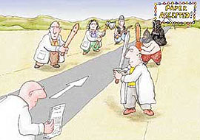
Final thoughts and questions

