Slide 1
Master of Science in Biostatistics Theory & Methods Track
Information Session
Emilia Bagiella, PhD & Emma K. T. Benn, DrPH
Program Co-Directors
Web: www.icahn.mssm.edu/MSbiostat
Email: MSbiostat@mssm.edu

Slide 2
Overview
About ISMMS
The Center for Biostatistics at ISMMS
What is Biostatistics?
Master of Science in Biostatistics – Theory & Methods
Program Overview
Program Eligibility
Curriculum
Admissions
Tuition & Financial Aid
Careers and Opportunities in Biostatistics

Slide 3

WELCOME TO THE ICAHN SCHOOL OF MEDICINE AT MOUNT SINAI!

Slide 4
About ISMMS
Chartered in 1963
Mission is to rigorously train the next generation of scientists and health professionals.
Almost 1800 graduate and medical students, and postdoctoral fellows enrolled in the 2017/2018 year
Leader in medical and scientific training, biomedical research and patient care.
Committed to intellectual exchange, multidisciplinary teamwork and innovation that can lead to discoveries and advances to improve the human condition.

Slide 5
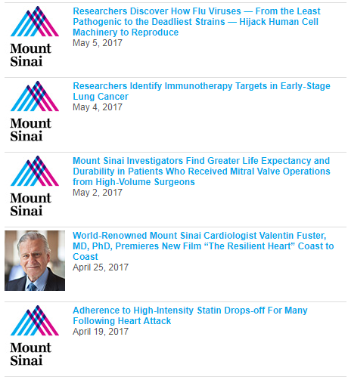
Research at ISMMS

Slide 6
The Center for Biostatistics at ISMMS
Established in 2011
16 faculty members
10 MS statisticians
Promote successful clinical and translational research at Mount Sinai
Educate medical students, graduate students, postdoctoral fellows, and other research staff

Slide 7
The Center for Biostatistics at ISMMS
Educational Programs
MPH Biostatistics track
MS in Biostatistics
Theory and Methods Track
Clinical Applications Track (For Clinical Professionals)
Biostatistics Summer Program for Clinical Research
The Applied Statistics in Biological Systems (ASIBS) Short Course
Support to the Clinical Research Program

Slide 8
Examples of research our MS Biostatisticians have contributed to:
Surgical ablation of atrial fibrillation during mitral-valve surgery. Gillinov AM, Gelijns AC, Parides MK, DeRose JJ Jr, Moskowitz AJ, Voisine P, Ailawadi G, Bouchard D, Smith PK, Mack MJ, Acker MA, Mullen JC, Rose EA, Chang HL, Puskas JD, Couderc JP, Gardner TJ, Varghese R, Horvath KA, Bolling SF, Michler RE, Geller NL, Ascheim DD, Miller MA, Bagiella E, Moquete EG, Williams P, Taddei-Peters WC, O'Gara PT, Blackstone EH, Argenziano M; CTSN Investigators. N Engl J Med. 2015 Apr 9;372(15):1399-409
Medical management with or without interventional therapy for unruptured brain arteriovenous malformations (ARUBA): a multicentre, non-blinded, randomised trial. Mohr JP, Parides MK, Stapf C, Moquete E, Moy CS, Overbey JR, Al-Shahi Salman R, Vicaut E, Young WL, Houdart E, Cordonnier C, Stefani MA, Hartmann A, von Kummer R, Biondi A, Berkefeld J, Klijn CJ, Harkness K, Libman R, Barreau X, Moskowitz AJ; international ARUBA investigators. Lancet. 2014 Feb 15;383(9917):614-21.
Costs associated with health care-associated infections in cardiac surgery. Greco G, Shi W, Michler RE, Meltzer DO, Ailawadi G, Hohmann SF, Thourani VH, Argenziano M, Alexander JH, Sankovic K, Gupta L, Blackstone EH, Acker MA, Russo MJ, Lee A, Burks SG, Gelijns AC, Bagiella E, Moskowitz AJ, Gardner TJ. J Am Coll Cardiol. 2015 Jan 6;65(1):15-23.
Effect of peer education on stroke prevention: the prevent recurrence of all inner-city strokes through education randomized controlled trial. Kronish IM, Goldfinger JZ, Negron R, Fei K, Tuhrim S, Arniella G, Horowitz CR. Stroke. 2014 Nov;45(11):3330-6.

Slide 9
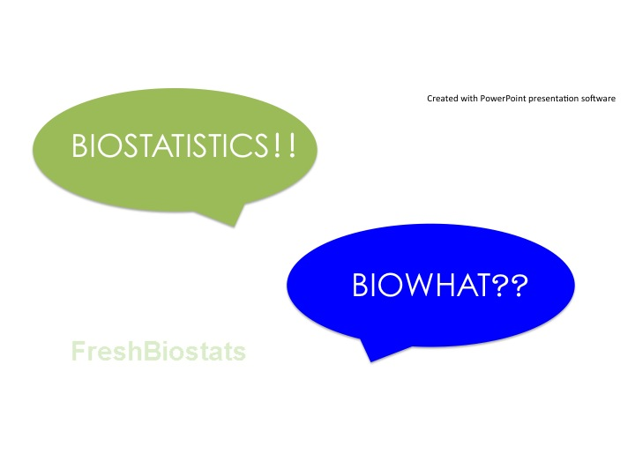
What is Biostatistics?
http://www.worldofstatistics.org/2013/02/11/biostatistics-unveiled/

Slide 10
What is Biostatistics?
Biostatistics is a branch of statistics that allows for the analysis and interpretation of scientific data generated in the clinical, public health, biomedical and translational sciences.
"By a small sample, we may judge of the whole piece." - Miguel de Cervantes (from Don Quixote)

Slide 11
What is Biostatistics?
Business
Economics, Engineering,
Marketing,
Computer Science
Physical
Sciences
Astronomy,
Chemistry, Physics
Areas where
STATISTICS
are used
Health &
Medicine
Genetics, Clinical Trials,
Epidemiology,
Pharmacology
Environment
Agriculture,
Ecology, Forestry,
Animal Populations
Government
Census, DOH, NCHS,
CDC, FDA, NIH
Adapted Figure from the American Statistical Association

Slide 12
Master of Science in Biostatistics – Program Overview
Sponsored by Center for Biostatistics & Department of Population Health Science and Policy at ISMMS
Designed to prepare individuals for:
Career as data analysts and applied statisticians in the biomedical sciences
PhD/DrPH in Biostatistics or Epidemiology or Bioinformatics
Distinctive, accelerated design
One year, full-time program
Comprehensive didactic training for conducting high-quality clinical and translational research
Curriculum emphasizes strong quantitative training to address complex challenges
Student-centered
Small cohort size (5 – 10 students)
Excellent mentorship and individualized attention
Uniquely positioned

Slide 13

The Graduate School of Biomedical Sciences Science That Changes Medicine
The Graduate School is uniquely positioned within a world-class medical school and health system. We have broken down the barriers to collaboration, allowing students to connect science, biostatistics, medicine, education and health care delivery.
Programs Across the Translational Health Continuum
Basic Sciences PhD Multidisciplinary Training Areas
PhD Program (Basic Sciences)
MD/PhD Program
MS in Biostatistics
MS in Biomedical Sciences
PhD in Clinical Research
MS Clinical Research
MS in Genetic Counseling
MS in Health Care Delivery Leadership
Masters in Public Health
MSW/MPH
Summer Undergraduate Research Program
Post Baccalaureate Research Education Program
Clinical Research Education Program
Advanced Certificate in Public Health
Physician Scholars PhD Program
Biophysics and Systems Biology
Cancer Biology
Developmental and Stem Cell Biology
Genetics and Genomic Sciences
Immunology
Microbiology
Neuroscience
Quick Facts
Ranked 2nd among private U.S. medical schools for NIH-sponsored funding per investigator
Over 285 Research Laboratories

Slide 14
Master of Science in Biostatistics – Program Eligibility
To be eligible for the MS in Biostatistics Program Theory & Methods Track, students must have:
At least two semesters of college-level calculus w/ grade of B or higher
At least 1 college-level linear algebra course w/ grade of B or higher
TOEFL for applicants from non-English speaking countries
GRE (optional)
Prior exposure to statistics/biostatistics not required
Knowledge of mathematical/statistical programming language not required, but certainly helpful

Slide 15
Master of Science in Biostatistics – Curriculum
One year curriculum = 31 core credits + ≥ 3 elective credits
FALL TERM
Course Title | Credits
Introduction to Advanced Biostatistics | 3
Fundamentals of Epidemiology | 3
Probability & Inference I | 3
Introduction to R Programming | 1
Capstone | 1
Clinical Trials Management (Elective) | 3
SPRING I TERM
Course Title | Credits
Theory of Linear and GLMs | 3
Analysis of Categorical Data | 3
Probability & Inference II | 3
Applied Biostatistics in Clinical Trials | 3
Capstone | 1
SPRING II TERM
Course Title | Credits
Analysis of Longitudinal Data | 3
Survival Analysis | 3
Capstone | 1
Pharmacoeconomics (Elective) | 3
Race and Causal Inference (Elective) | 3
Required Credits | 31
Minimum Elective Credits | 3
Total Credits | 34

Slide 16
Master of Science in Biostatistics – Curriculum
Capstone Objectives
Engage students in important discourse surrounding data management and research ethics – Fall Term
Challenge students to operationalize conceptual research questions into testable hypotheses and to determine the appropriate analytic methods to test their hypotheses – Spring I Term
Provide students with the opportunity to shadow Biostatistics faculty in the Center for Biostatistics consultation service – Spring II Term
Learn how to successfully collaborate with non-statisticians (primarily clinical faculty) at ISMMS
Contribute appropriate study design-related and methodologic solutions to cutting edge research questions
Conduct mentor-guided preliminary analyses
Disseminate findings to an institution-wide audience at the annual MS in Biostatistics Capstone Symposium

Slide 17
Master of Science in Biostatistics – Admissions
Theory & Methods Track Fall Application Deadline
Start Accepting Application: September 15th
Final Application Deadline: April 1st
Online application: https://applygs.mssm.edu
Application components
Online application
Background and demographics
Personal statement (≤700 words) – motivation for applying and post-graduation career objectives
Current CV or resume
Non-refundable application fee ($80)
Official Transcripts – undergraduate and graduate (if applicable)
Mail to:
ISMMS Office of Admissions
One Gustave L. Levy Place
Box 1002
New York, NY, 10029
Two Letters of Recommendation
Recommenders email LORs directly to admissions@mssm.edu
GRE (optional) and TOEFL (if international and non-English speaking) to School Code 2464

Slide 18
Master of Science in Biostatistics – Tuition & Financial Aid
Application fee $80
Tuition is currently $41K
Student and Activity Fees are $150
Health Insurance Required
Financial Aid Available

Slide 19
Master of Science in Biostatistics – Tuition & Financial Aid
Eligible students submit the FAFSA. (US Citizen/eligible non-citizen)
Types of aid available -Stafford Loans -Federal Direct Graduate PLUS -Private Loans
We recommend applying for financial aid by August 1st
School code is G07026
FAFSA Website https://fafsa.ed.gov/

Slide 20
Master of Science in Biostatistics – Tuition & Financial Aid
Stafford Loans Unsubsidized
$26,000/year
Repayment begins 6 months after graduation
Direct Plus Loans
Credit based and covers full out-of-pocket cost including living expenses
Repayment begins immediately, but can be deferred while enrolled

Slide 21
Master of Science in Biostatistics
Resources
ISMMS: www.icahn.mssm.edu
Center for Biostatistics: www.icahn.mssm.edu/centerforbiostatistics
MS in Biostatistics Program Website: www.icahn.mssm.edu/MSbiostat
MS in Biostatistics Program Email: Msbiostat@mssm.edu
MS in Biostatistics Program Co-Directors:
Emilia Bagiella, PhD – emilia.bagiella@mountsinai.org
Emma K. T. Benn, DrPH – emma.benn@mountsinai.org
MS in Biostatistics Administrative Educational Coordinator:
Mary Sandre – mary.sandre@mountsinai.org
Housing Resources:
International House of New York: http://www.ihouse-nyc.org
Hotel Alexander: http://www.hotelalexandernyc.com/student_housing.html

Slide 22
Careers and Opportunities in Biostatistics
“Biostatisticians with advanced degrees can look forward to excellent career opportunities in government, industry, and academia.” – American Statistical Association
Career opportunities:
Academic Medical Centers
Pharmaceutical Industry
Contract Research Organizations (CROs)
US Food and Drug Administration
Centers for Disease Control & Prevention
State Departments of Health
US Census Bureau
National Institutes of Health
Foundations

Slide 23
Careers and Opportunities in Biostatistics
Clinical Trials Design and Conduct
Public Health applications
Quality Control
Genetics and Genomics
Basic Sciences
Personalized Medicine
Big Data
Teaching

Slide 24
Careers and Opportunities in Biostatistics
Job placement within 3-4 months from graduation
Median salary at first hire : $60K - $70K
Opportunities for growth

Slide 25
