Slide 1
Mount Sinai DEA/BNE
Compliance Strategy
February 5, 2024
Jonathan A. Cohen, DVM DACLAM
Associate Professor and Director
Center for Comparative Medicine and Surgery
IACUC Basic Science Forum

Slide 2
Controlled Substances Act (CSA)
  Title II of the Comprehensive Drug Abuse Prevention and Control Act of 1970
  The United States drug policy by which the manufacture, possession, use and distribution of controlled substances is regulated.
    certain narcotics, stimulants, depressants, hallucinogens, anabolic steroids and other chemicals

Slide 3
What is a Controlled Substance?
  A controlled substance is a drug or chemical whose manufacture, possession, storage, use or disposal is regulated by the Drug Enforcement Administration (DEA)
  Included are all chemical substances in Schedules I-V of the Controlled Substances Act and any listed in the state laws of New York

Slide 4
Controlled Substances
  Placement of a controlled substance into one of the five Schedules is based on the following:
    Medical use
    Potential for abuse
    Psychological or physiological dependence
  Since 1970, many substances have been added, removed, or transferred from one schedule to another.
  An updated list of the schedules is published annually in Title 21 Code of Federal Regulations (CFR) 1308.11-1308.15

Slide 5
Schedule I Controlled Substances
No currently accepted medical use in the United States, a lack of accepted safety for use under medical supervision, and a high potential for abuse
  Heroin
  Lysergic acid diethylamide (LSD)
  Marijuana (cannabis)
  Peyote
  Methaqualone
  3,4-methylenedioxymethamphetamine (“Ecstasy”)

Slide 6
Schedule II/IIN Controlled Substances
High potential for abuse which may lead to severe psychological or physical dependence. Examples include:
  Methadone
  Oxycodone
  Fentanyl
  Morphine
  Opium
  Codeine
  Cocaine
  Methamphetamine

Slide 7
Schedule III/IIIN Controlled Substances
Potential for abuse is less then substances in Schedules I or II and abuse may lead to moderate or low physical or high psychological dependence.
  Benzphetamine
  Phendimetrazine
  Ketamine
  Anabolic steroids
  Buprenorphine

Slide 8
Schedule IV Controlled Substances
Low potential for abuse relative to substances in Schedule III.
  Alprazolam
  Carisoprodol
  Clonazepam
  Clorazepate
  Diazepam
  Lorazepam
  Midazolam
  Temazepam

Slide 9
Schedule V Controlled Substances
Low potential for abuse relative to substances in Schedule IV and contain preparations containing limited quantities of certain narcotics.
  Ezogavine
  Lomotil
  Motofen
  Lyrica
  Parepectolin
  Cough preparations (Robitussin AC, Phenergan with Codeine)

Slide 10

Controlled Substances
Policy update
  Before ordering controlled substances, each Mount Sinai Principal Investigator must have a license/registration from:
    Bureau of Narcotic Enforcement (BNE)
    Drug Enforcement Administration (DEA)
      NOTE: The Drug Enforcement Administration is a law enforcement agency and can prosecute violators of the Controlled Substances Act
      The DEA will not provide a federal license until the PI obtains a state license.

Slide 11
Application Process
The Bureau of Narcotic Enforcement (BNE) is part of the New York State Department of Health.
The Drug Enforcement Administration (DEA) requires you to have BOTH a BNE (state license) and a DEA license to purchase and use controlled substances in research settings
The application for the BNE is located here (DOH-4330)
https://www.health.ny.gov/forms/doh-4330.pdf
DEA application
https://www.deadiversion.usdoj.gov/drugreg/registration.html

Slide 12
NYSDOH Basic Application Details

Slide 13
NYSDOH Basic Application Details Appendix A1
Insert CV
• Insert Project Description (from grant or funding source)
• Insert IACUC approval letter and relevant segments of the approved IACUC Animal Protocol (please ensure that requested controlled substances are captured/described in the document)

Slide 14
NYSDOH Basic Application Details
Checklist for NYS DOH License Application
Completed DOH-4330 application with appropriate signatures
Completed Appendix A1 (one appendix needed for each IACUC protocol) Application fee $40: scan/photocopy of check/money order to NYS DOH Bureau of Narcotics Enforcement
Curriculum Vitae of proposed licensee
Copies of approved IACUC protocol Policies and procedures for safe storage of C.S. and methods used to reduce potential for diversion
Copy of DEA registration (only applicable for clinicians with existing DEA registration
Digital photographs of all storage and security
  • Entrance and exits to the room where storage is installed
  • All areas of the room where storage is installed (to provide a 360-degree view)
  • All storage closed/locked and open to reveal all locking mechanisms and compartments
  • All security measures in place (key card access, alarm systems, locked doors, etc.)

Slide 15
NYSDOH BNE On-site Visit
Once the application has been submitted
Appropriate storage is installed,
The NYS Bureau of Narcotics Enforcement will schedule an onsite visit
  review the storage and documentation of the potential registrant.

Slide 16
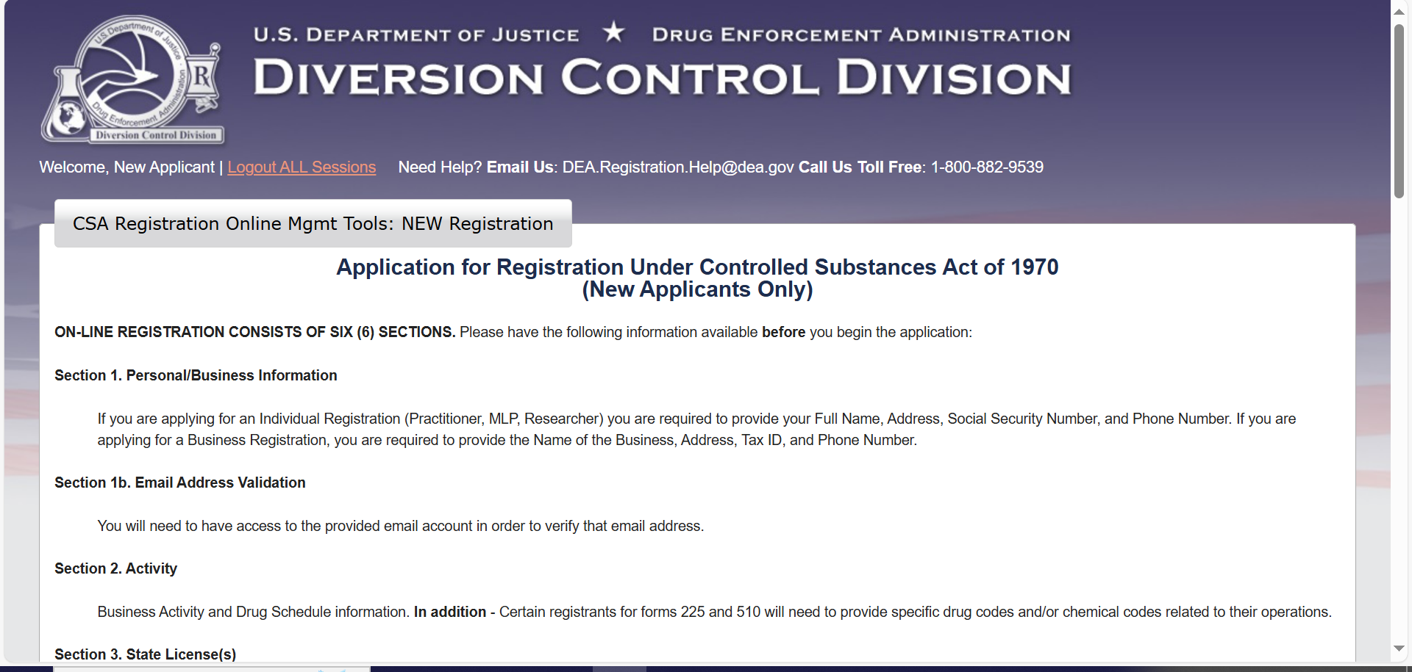
Getting a DEA License
To obtain a DEA registration, a researcher must apply using a DEA Form 225. Applicants may submit the form by hard copy or online.
https://apps.deadiversion.usdoj.gov/webforms2/spring/main?execution=e1s1 (DEA Diversion Internet Web Site)
DEA Headquarters’ Registration Section in Washington, D.C. at 1-800-882-9539 (Registration Call Center)

Slide 17
DEA Application process
Researchers must submit an application for a registration for either Schedule I or Schedule II-V:
Note: Similar to NYS DOH, if you seek to use both Schedule I and Schedule II – V, you will need to submit separate applications for each registration.
Schedule I applications require more detail
Must file and receive approval for a complete research protocol
▪ Supplemental protocol that includes detailed information C.S. use locations and procedures for storage, dispensing, and security to prevent diversion
▪ IACUC Approval Letter
▪ Curriculum Vitae of proposed registrant
Checklist for DEA Registration Application
▪ Completed DEA Form 225: Application for Registration under Controlled Substances Act
▪ $296 application fee paid by credit card
▪ Copy of state license from NYS Dept. of Health
▪ Completed Power of Attorney (Schedule I & II only)

Slide 18
DEA Onsite visit
Once applications have been submitted:
The DEA will schedule an on-site inspection to review storage, material logging requirements, and researcher protocols similar to the NYS DOH.
This inspection is separate from the inspection by the NYS DOH
You may commence work with scheduled materials only after you have received both a license from the NYS DOH and a registration from the DEA.

Slide 19
Investigator Responsibilities
  DEA Registrants/NYS Licensed individual are legally responsible for managing the controlled substances in accordance with the regulations, including inventory, recordkeeping, and security provisions.
  Specifically, they are responsible for:
    Obtaining and maintaining appropriate licensure from the NYSDOH Bureau of Narcotics Enforcement- Form DOH 4330.
    Obtaining and maintaining appropriate registration from the US DEA (Based on Category; Research – Form 225/225a).
    Safeguarding controlled substances obtained through their license/registration from receipt until their destruction/disposal.
    Establishing security measures for the purchase, acceptance, use, and ultimate disposal of the controlled substances used in their research.

Slide 20
Supervisor of Controlled Substance Activity
Supervisor of Controlled Substance Activity (Supervisor) is an individual who undertakes responsibilities including ordering, receiving, inventory, recordkeeping, and dispensing on behalf of the registrant.
The role is officially designated by the registrant on form DOH-4330.
Supervisors will generally have access to the entire inventory of stored controlled substances.
To take on supervisory responsibilities with schedules I & II controlled substances, a Power of Attorney must be officially completed, signed, and kept on file by the registrant.

Slide 21
Authorized Users
Authorized Users are trusted lab members who receive controlled substances under authorized supervision of the primary DEA registrant or supervisor.
Authorized users of controlled substances are responsible for managing the controlled substances in accordance with regulations, including inventory, record keeping, and security provisions.
They are responsible for following established security measures for the storage, use, and ultimate disposal of the controlled substances used in their research.
They must be listed on the animal use or research protocol detailed on the registrant’s NYS DOH License. Authorized Users only have access to materials dispensed to them by the registrant or supervisor, generally dilutions.

Slide 22
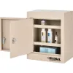
Security Requirements
    Ensure that controlled substances are stored in a manner that prevents their theft or misuse
    Store controlled substances at the location specified in the registration
      Working Stock and Main Stock storage locations required
      Schedule III-V working stock require a double-locked, substantially constructed cabinet that is fixed permanently in place
      Schedule III-V Main stock stationary securely locked cabinet of substantial construction.
    Ensure that only authorized users have access to controlled substances
    Keep the storage unit locked when not in use
    Do not use bicycle locks, clasp locks or any other locking device that can be cut off the cabinet used for storing controlled substances

Slide 23
Security Requirements
New York State Department of Health Controlled Substance Minimum Storage Requirements - Class 4 and 7
 | Schedule I & II | Schedule III - V
Reserve and Main Stock | A Safe with a TL rating of 30 or higher or a vault with a GSA class 5 rating. Safes weighing <750lbs. Must be bolted to the floor. | A cabinet that is stationary, securely locked, and of substantial construction (i.e., steel).
Working Solutions | A cabinet that is stationary, securely locked, and double- doored. Both cabinets must have key-locked doors with separate keys. Cabinets must be made of steel or other approved metal. | A cabinet that is stationary, securely locked, and double- doored. Both cabinets must have key-locked doors with separate keys. Cabinets must be made of steel or other approved metal. * Schedule V does not require double door feature
*Find recommended vendors on CCMS and/or IACUC website

Slide 24

Record Keeping
  Records for schedule I and schedule II substances should be kept separately from records for schedule III-V
  Inventory for all locations must be updated every 2 years. The inventory will consist of:
    Hands-on counting of inventory
    Complete within a single business day
    Inventory must be maintained at the Registered Location (The inventory can be written, typewritten, or printed.)
    Label the inventory “Biennial Inventory” (If nothing to record – indicate “0”)
    See log templates on CCMS and/or IACUC websites
      Receipt Log, Usage Log, Biennial Inventory Log

Slide 25
Record Keeping cont.
  Usage logs must be maintained for controlled substances at each physical location where they are stored
  The use of controlled drugs are always documented by the date, purpose, amount used, balance remaining and the initials of the person administering the drug.
All records must be maintained by Licensed individual/registrant for a period of at least five years from the date of the last recorded purchase, transfer, use, or other transaction involving the controlled substance

Slide 26
Disposal
Licensed individual/registrants should make every effort to limit the amount of controlled substances requiring disposal by monitoring expiration dates and ensuring use of controlled substances within the appropriate timeframe, as well as limiting purchase/storage of controlled substances to appropriate quantities (e.g., sufficient to support the equivalent of 3-months of research).
Disposal and/or surrender of controlled substances must be in accordance with applicable laws and regulations including, among others, 10 N.Y.C.R.R. § 80.51-52 and 21 C.F.R. § 1307.21.
If controlled substances expire or otherwise require disposal, the Licensed individual/registrant should contact a NYS DOH approved Reverse Distributor
  (https://www.health.ny.gov/professionals/narcotic/licensing_and_certification/docs/reverse_distr ibutor.pdf) and arrange for the documented return of the controlled substances through a reverse distribution process.

Slide 27
Disposal
All controlled substances must remain securely stored in accordance with the “Storage” section of this Policy while awaiting NYS DOH and DEA approval for disposal.
Expired pharmaceuticals previously intended for use with animals must be clearly labeled to avoid accidental administration.
If controlled substances are discovered for which registration cannot be ascertained, please contact EnvH&S for guidance.
Any person disposing of a controlled substance must maintain written records containing:
  Date of return or destruction;
  Name, form, quantity of the substance returned or destroyed;
  Name, address, registry number of the person making the return;
  Name, address, registry number of the supplier or manufacturer to whom the substances are returned or the name and license number of the persons performing and witnessing the destruction.

Slide 28
Inspections
The DEA makes periodic unannounced inspections of registered controlled substance storage locations.
Additionally, amendments/changes, reporting a loss or theft may prompt a BNE/ DEA inspection or visit.
  The DEA is a law enforcement agency, with the ability to assess civil and criminal penalties
During the IACUC semi-annual inspections, representatives will review storage areas, use/logs, and security controls.
store controlled substances at the location specified in the registration, in
a double-locked, substantially constructed cabinet that is fixed in place

Slide 29
Non-Compliance
Observations of non-compliance will result in recommended corrective actions with communications to appropriate personnel including the Department Chair, Dean, Dean for Research, and/or U.S. DEA
Consequences of non-compliance may include
  loss of authorization to use controlled substances at ISMMS
  revocation of the DEA registration
  referral to law enforcement agencies.
store controlled substances at the location specified in the registration, in

Slide 30
Questions
CCMS Town Hall
  February 26th
All materials presented will be housed on the CCMS website for further review
  Controlled Substance SOP
  Draft applications
  FAQs
  Record keeping templates
Email any urgent questions to:
dea-bne@mtsinai.onmicrosoft.com

